Slide 1

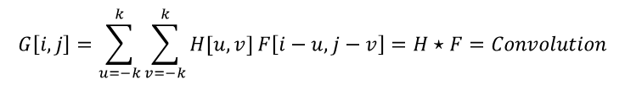
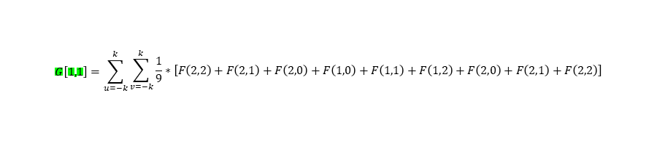
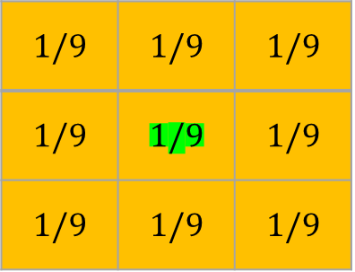
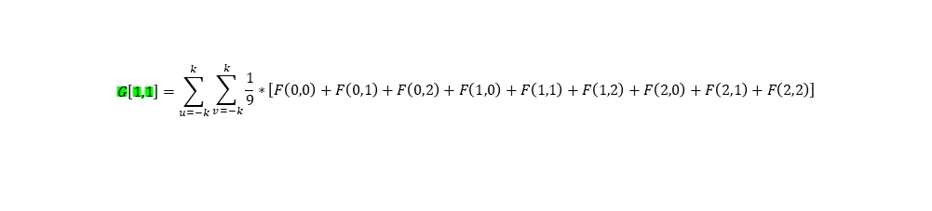
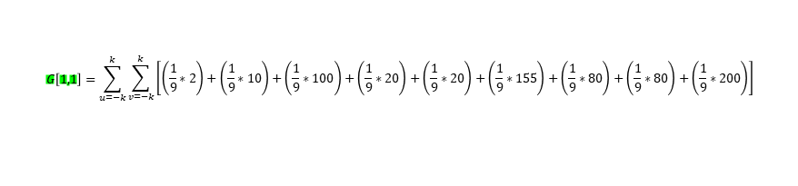
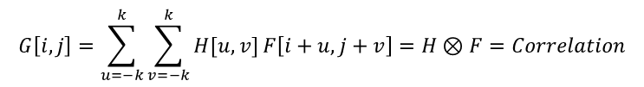

$$G\left[i,j\right]=\sum_{u=−k}^{k}{\sum_{v=−k}^{k}{H[u,v]}}F\left[i−u,j−v\right]=H⋆F=Convolution$$
2 | 10 | 100 | 50 | 45 | 12 | 33 | 11
20 | 20 | 155 | 150 | 160 | 80 | 60 | 10
80 | 80 | 200 | 245 | 255 | 80 | 80 | 30
2 | 10 | 100 | 50 | 45 | 12 | 33 | 11
20 | 20 | 155 | 150 | 160 | 80 | 60 | 10
80 | 80 | 200 | 245 | 255 | 80 | 80 | 30
50 | 50 | 10 | 10 | 240 | 245 | 244 | 244
20 | 20 | 155 | 150 | 160 | 80 | 60 | 10
$$G\left[1,1\right]=\sum_{u=−k}^{k}{\begin{aligned}\sum_{v=−k}^{k}{\left[\left(\frac{1}{9}∗2\right)+\left(\frac{1}{9}∗10\right)+\left(\frac{1}{9}∗100\right)+\left(\frac{1}{9}∗20\right)+\left(\frac{1}{9}∗20\right)+\left(\frac{1}{9}∗155\right)+\left(\frac{1}{9}∗80\right)+\left(\frac{1}{9}∗80\right)+\left(\frac{1}{9}∗200\right)\right]} \\ \end{aligned}}$$
$$G\left[1,1\right]=\sum_{u=−k}^{k}{\begin{aligned}\sum_{v=−k}^{k}{\frac{1}{9}∗\left[F\left(0,0\right)+F\left(0,1\right)+F\left(0,2\right)+F\left(1,0\right)+F\left(1,1\right)+F\left(1,2\right)+F\left(2,0\right)+F\left(2,1\right)+F\left(2,2\right)\right]} \\ \end{aligned}}$$
$$G\left[i,j\right]=\sum_{u=−k}^{k}{\sum_{v=−k}^{k}{H[u,v]}}F\left[i+u,j+v\right]=H⊗F=Correlation$$
$$G\left[1,1\right]=\sum_{u=−k}^{k}{\begin{aligned}\sum_{v=−k}^{k}{\frac{1}{9}∗\left[F\left(2,2\right)+F\left(2,1\right)+F\left(2,0\right)+F\left(1,0\right)+F\left(1,1\right)+F\left(1,2\right)+F\left(2,0\right)+F\left(2,1\right)+F\left(2,2\right)\right]} \\ \end{aligned}}$$
K=1 $↔$ filter Size $3×3$
$$1/9$$ | $$1/9$$ | $$1/9$$
$$1/9$$ | $$1/9$$ | $$1/9$$
$$1/9$$ | $$1/9$$ | $$1/9$$
$$filterSize=2k+1$$

Slide 2

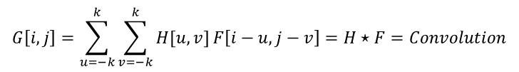

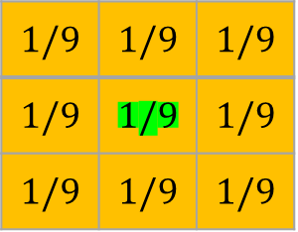






Convolution for G[1,1] in [G-result image]
2 | 10 | 100 | 50 | 45 | 12 | 33 | 11
20 | 20 | 155 | 150 | 160 | 80 | 60 | 10
80 | 80 | 200 | 245 | 255 | 80 | 80 | 30
2 | 10 | 100 | 50 | 45 | 12 | 33 | 11
20 | 20 | 155 | 150 | 160 | 80 | 60 | 10
80 | 80 | 200 | 245 | 255 | 80 | 80 | 30
50 | 50 | 10 | 10 | 240 | 245 | 244 | 244
20 | 20 | 155 | 150 | 160 | 80 | 60 | 10
$$G\left[i,j\right]=\sum_{u=−k}^{k}{\sum_{v=−k}^{k}{H[u,v]}}F\left[i−u,j−v\right]=H⋆F=Convolution$$
$$Iter1⇒{v=−1 \atop u=−1}⇒F\left[1−\left(−1\right),1−\left(−1\right)\right]=F[2,2]$$
$$Iter2⇒{v=0 \atop u=−1}⇒F\left[1−\left(−1\right),1−0\right]=F[2,1]$$
$$Iter3⇒{v=1 \atop u=−1}⇒F\left[1−\left(−1\right),1−1\right]=F[2,0]$$
$$Iter4⇒{v=−1 \atop u=0}⇒F\left[1−0,1−(−1)\right]=F[1,2]$$
$$Iter5⇒{v=0 \atop u=0}⇒F\left[1−0,1−0\right]=F[1,1]$$
$$Iter7⇒{v=−1 \atop u=1}⇒F\left[1−1,1−(−1)\right]=F[0,2]$$
$$1/9$$ | $$1/9$$ | $$1/9$$
$$1/9$$ | $$1/9$$ | $$1/9$$
$$1/9$$ | $$1/9$$ | $$1/9$$
K=1 $↔$ filter Size $3×3$
$$filterSize=2k+1$$

Slide 3

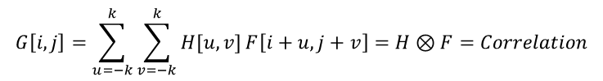

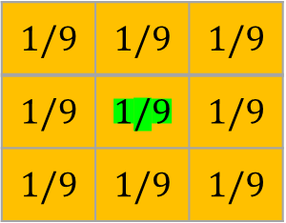







Correlation (2D cross Correlation) for G[1,1] in [G-result image]
$$G\left[i,j\right]=\sum_{u=−k}^{k}{\sum_{v=−k}^{k}{H[u,v]}}F\left[i+u,j+v\right]=H⊗F=Correlation$$
$$G\left[1,1\right]=\left[F\left(0,0\right)+F\left(0,1\right)+F\left(0,2\right)+F\left(1,0\right)+F\left(1,1\right)+F\left(1,2\right)+F\left(2,0\right)+F\left(2,1\right)+F\left(2,2\right)\right]$$
$$Iter1⇒{v=−1 \atop u=−1}⇒F\left[1+\left(−1\right),1+\left(−1\right)\right]=F[0,0]$$
$$G\left[1,1\right]=\left(\frac{1}{9}∗2\right)+\left(\frac{1}{9}∗10\right)+\left(\frac{1}{9}∗100\right)+\left(\frac{1}{9}∗20\right)+\left(\frac{1}{9}∗20\right)+\left(\frac{1}{9}∗155\right)+\left(\frac{1}{9}∗80\right)+\left(\frac{1}{9}∗80\right)+\left(\frac{1}{9}∗200\right)$$
$$G\left[1,1\right]=74.111$$
$$Iter2⇒{v=0 \atop u=−1}⇒F\left[1+\left(−1\right),1+0\right]=F[0,1]$$
74.1
$$Iter3⇒{v=1 \atop u=−1}⇒F\left[1+\left(−1\right),1+1\right]=F[0,2]$$
$$Iter4⇒{v=−1 \atop u=0}⇒F\left[1+0,1+(−1)\right]=F[1,0]$$
2 | 10 | 100 | 50 | 45 | 12 | 33 | 11
20 | 20 | 155 | 150 | 160 | 80 | 60 | 10
80 | 80 | 200 | 245 | 255 | 80 | 80 | 30
2 | 10 | 100 | 50 | 45 | 12 | 33 | 11
20 | 20 | 155 | 150 | 160 | 80 | 60 | 10
80 | 80 | 200 | 245 | 255 | 80 | 80 | 30
50 | 50 | 10 | 10 | 240 | 245 | 244 | 244
20 | 20 | 155 | 150 | 160 | 80 | 60 | 10
$$Iter5⇒{v=0 \atop u=0}⇒F\left[1+0,1+0\right]=F[1,1]$$
$$Iter7⇒{v=−1 \atop u=1}⇒F\left[1+1,1+(−1)\right]=F[2,0]$$
K=1 $↔$ filter Size $3×3$
$$1/9$$ | $$1/9$$ | $$1/9$$
$$1/9$$ | $$1/9$$ | $$1/9$$
$$1/9$$ | $$1/9$$ | $$1/9$$
$$filterSize=2k+1$$

